Slide 1
FINAL PROJECT
GRAZI PHOTOS & VIDEOS WEBSITE

Slide 2
Problem/Idea/Concept/Topic Statement
A Website offering photos and video production services for weddings, birthday parties and events in general including my makeup services.
My end users are young adults and/or adults about to get married; parents who want to record special moments with their kids; kids; promoters; artists; and any person interested in having a photoshoot.
The end-users should understand my style as a professional and feel comfortable requesting my services through the website. They also should know how to navigate on the internet and understand the basics of how to navigate on a website.
My goal as a designer/ photo and video producer is to create a good website to show my services in an efficient way (including photoshoots and videos that I created) and provide the best services to my end-users.

Slide 3
Needs Assessments
The challenges I face as a designer are to use the ideal codes to provide a nice style to the webpage and manage software to edit photos and videos. Also, to provide the best services to my clients I must know how to deal with them by being professional and reasonable.
The end users should have an idea of what style of photography they are looking for, so that I can tailor my services to meet their needs. After navigating my website and checking my work, they will be able to contact me and take a survey regarding the website.
I will need to know their schedule to check what would be the best time that works for us; and what type of services they are looking for. I will collect this information by email or phone after they contact me.
I will know that my goals are met if they show satisfaction after I provide my product and if they show interest to request my services again.

Slide 4
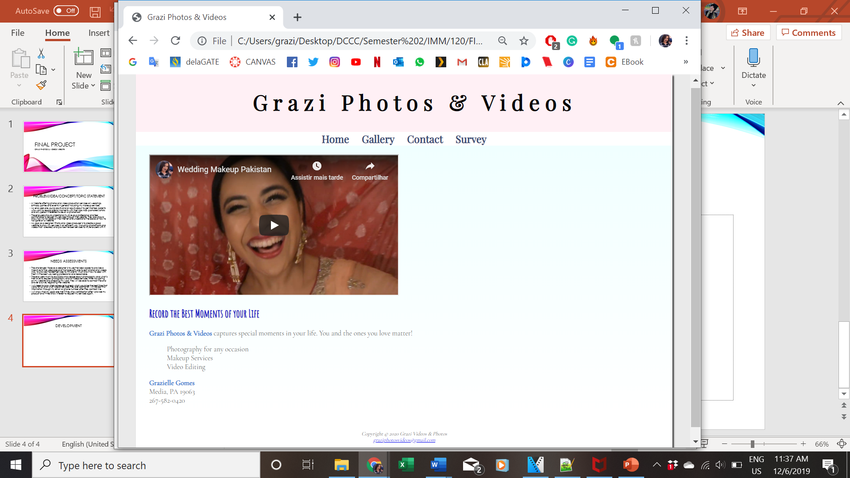
Introductory screen

Slide 5
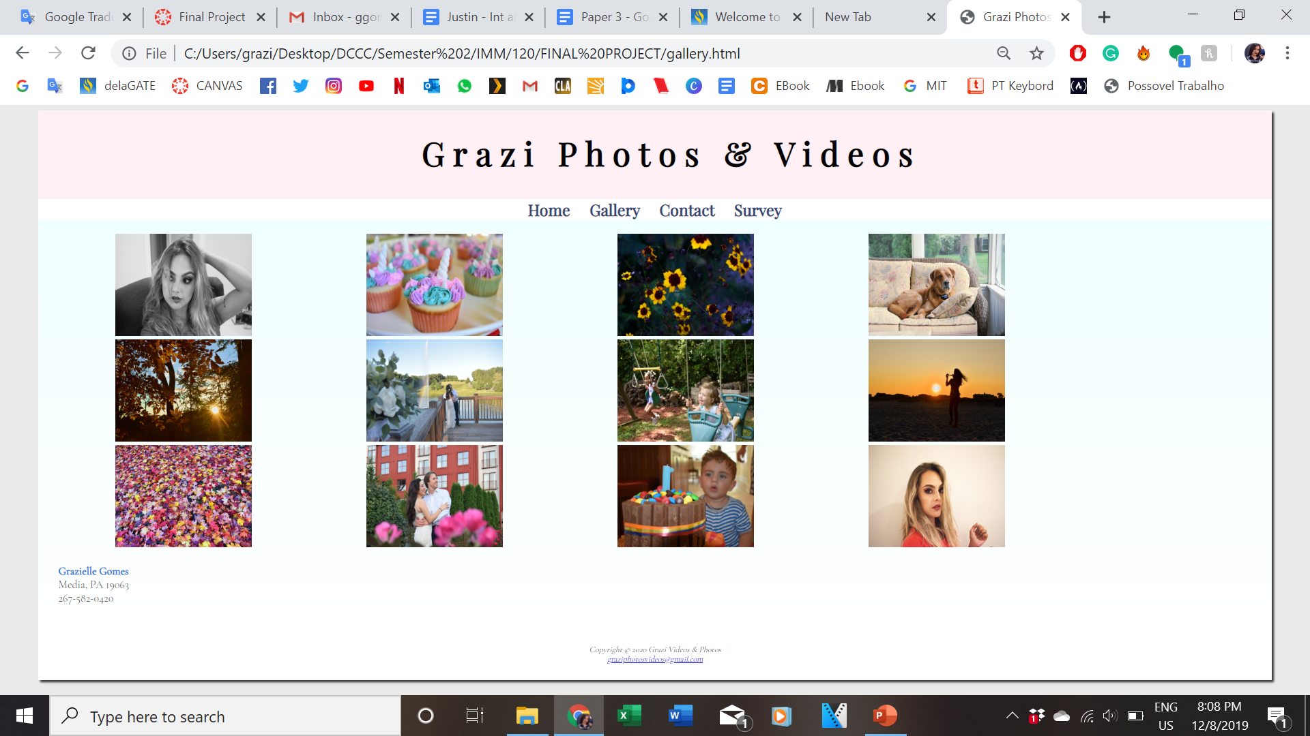
MY GALLERY PAGE
Each photo was
edited on
Photoshop

Slide 6
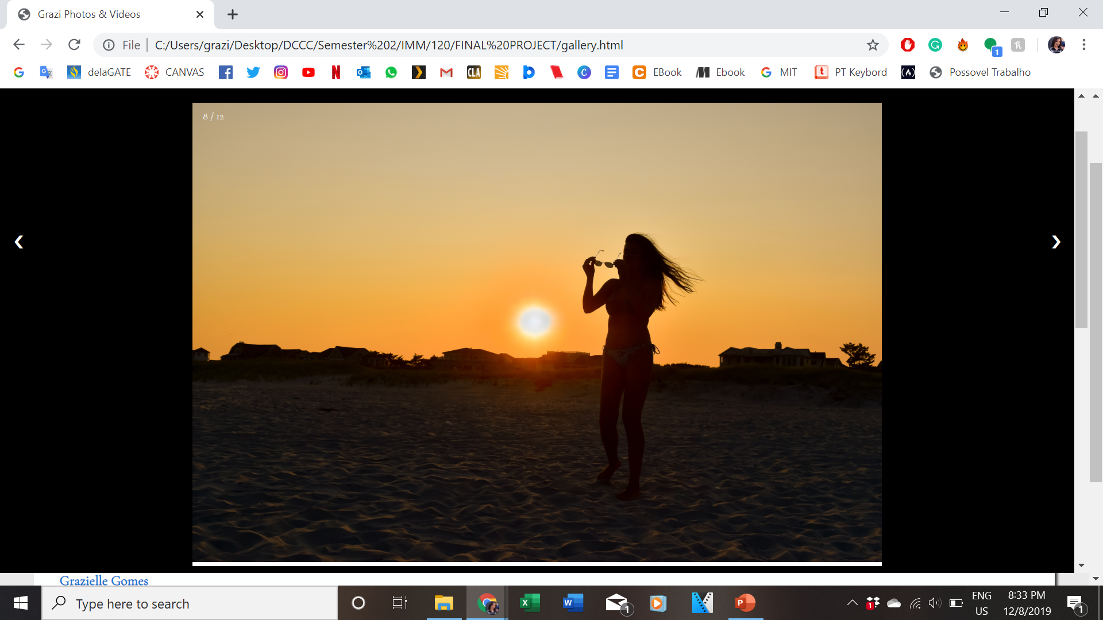
This is how a photo looks like when its clicked on the gallery

Slide 7
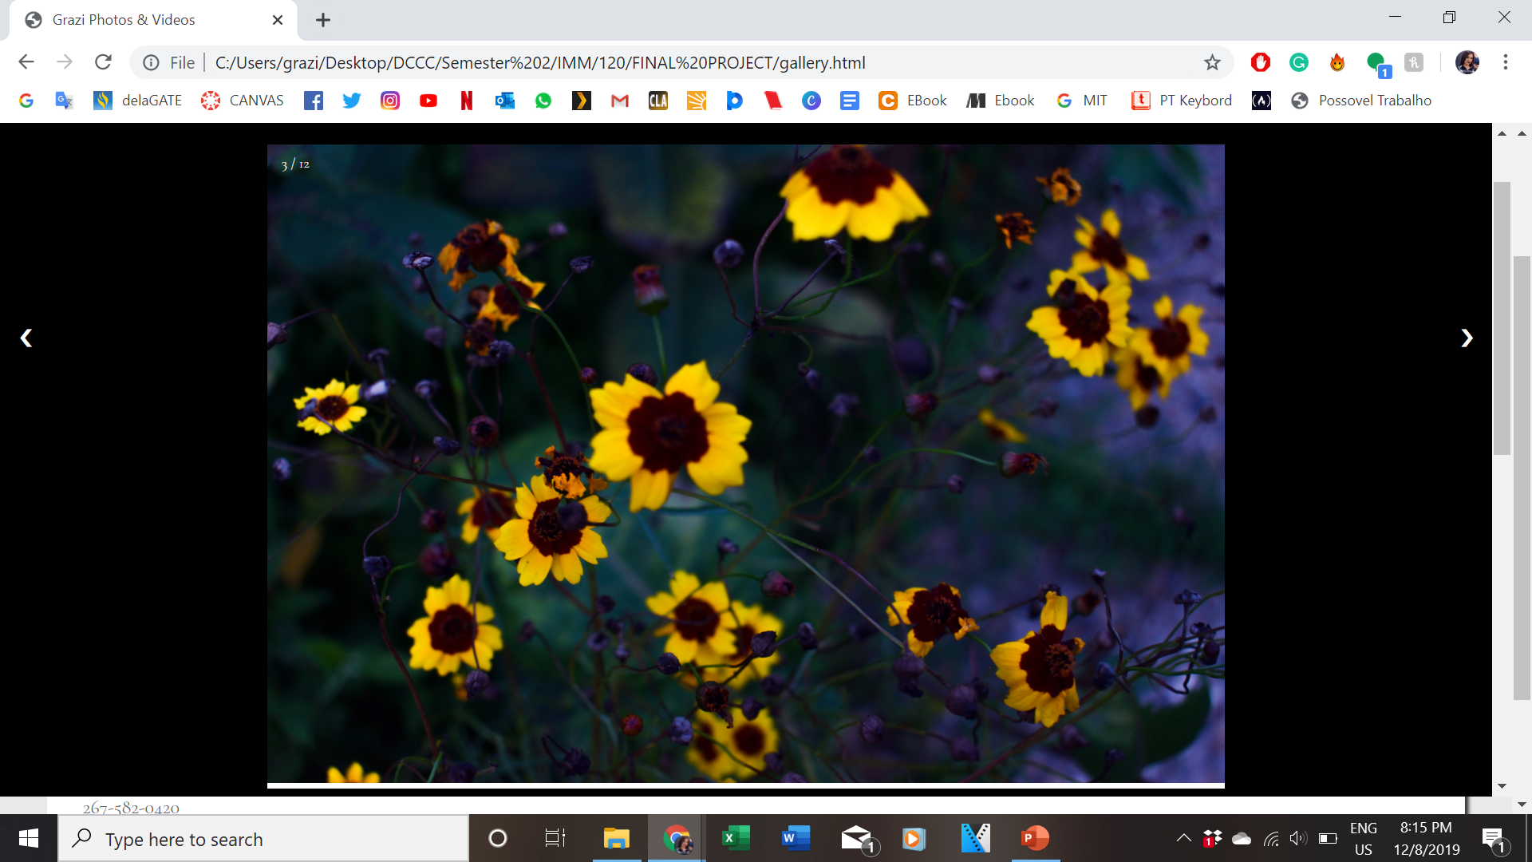

Slide 8
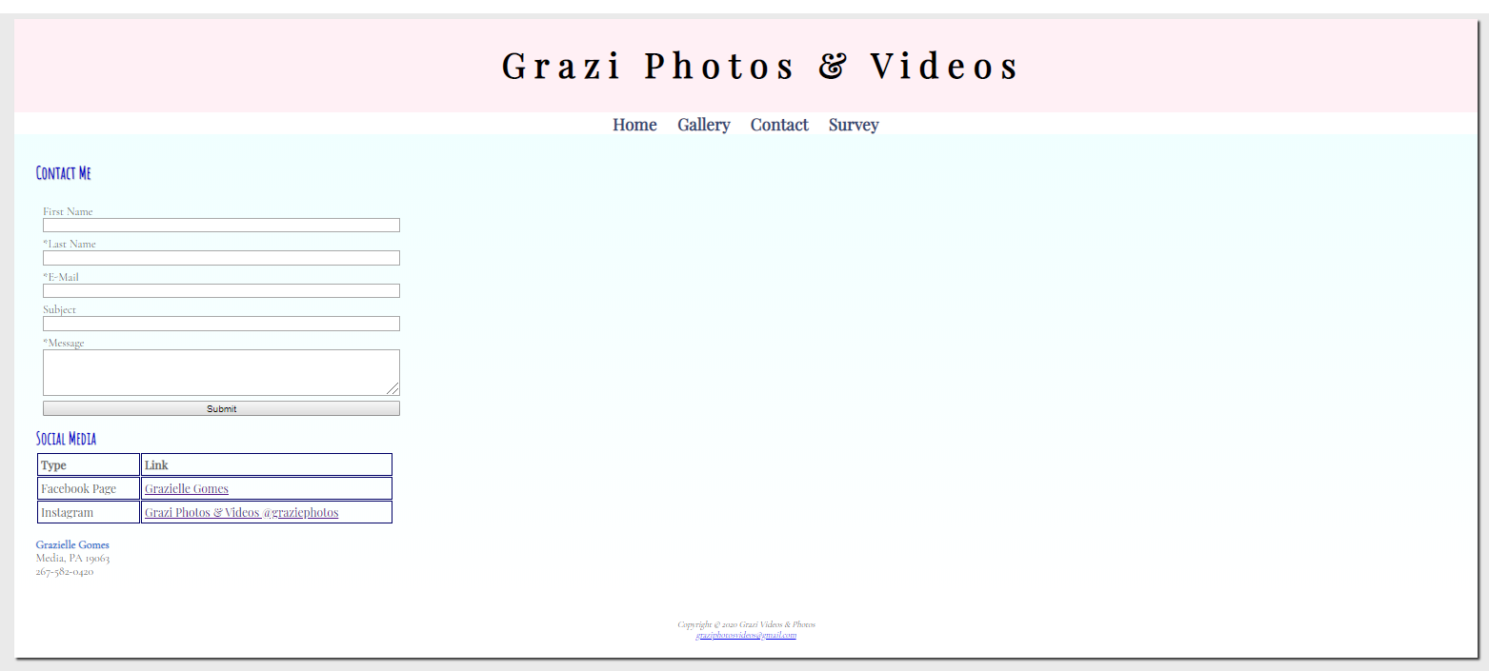
Contact page

Slide 9
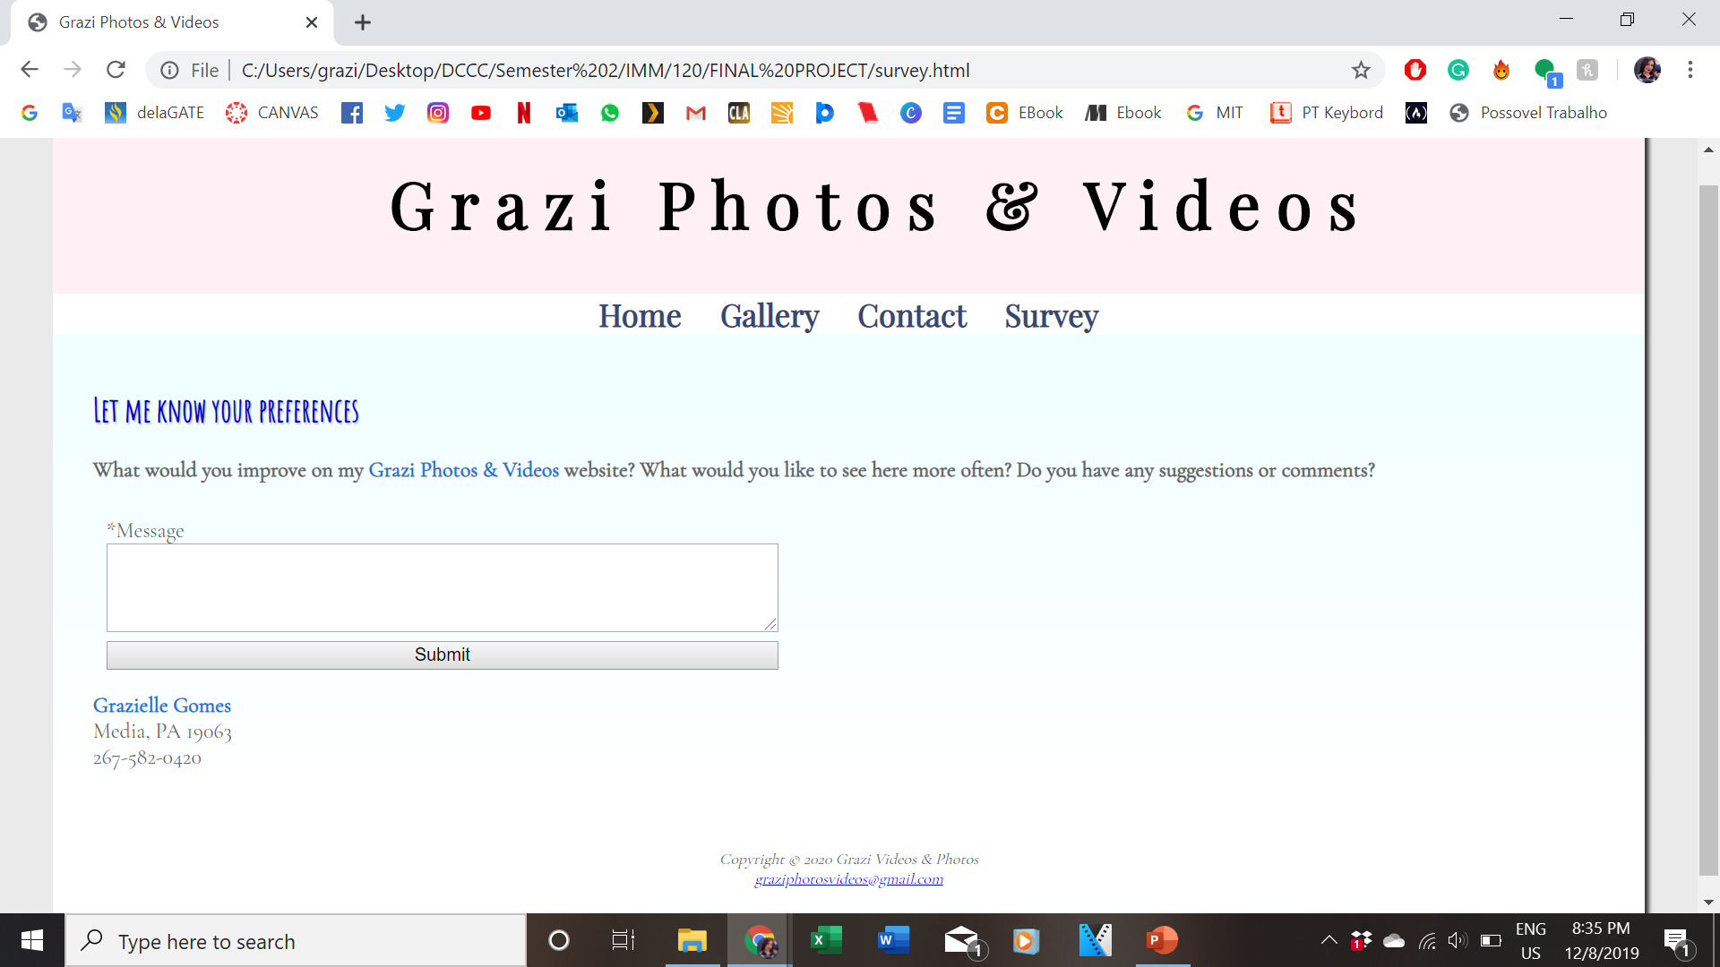
Survey page

Slide 10
What’s next?
To improve my abilities to expand webpages, I will take more classes to learn new programming languages.
I will read the surveys replies and consider the client’s opinions about the website. There are so many things I still need to work on, but with their help, I will be able to improve my website.
Finally, I will know if the website was efficient when I start getting requests for the services I am offering.

Slide 11
What did you learn as you went through this design process?
I learned new photoshop tools, which is perfect to help me with my photo editing
I learned the concepts of interactive multimedia
I have a better understanding how each media works
How to work with graphics and logos on Photoshop
How to be more critical about interactive multimedia

